Slide 1

Module 2.2: Advanced Pandas
Dennis J. Zhang
Washington University in St. Louis

Slide 2
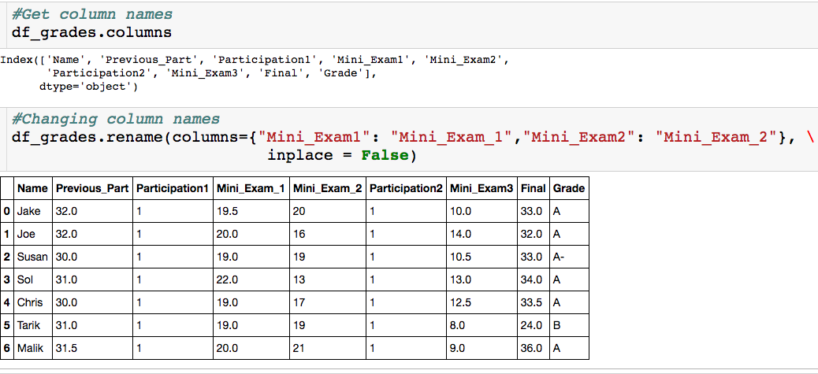
Changing Column Names

Slide 3
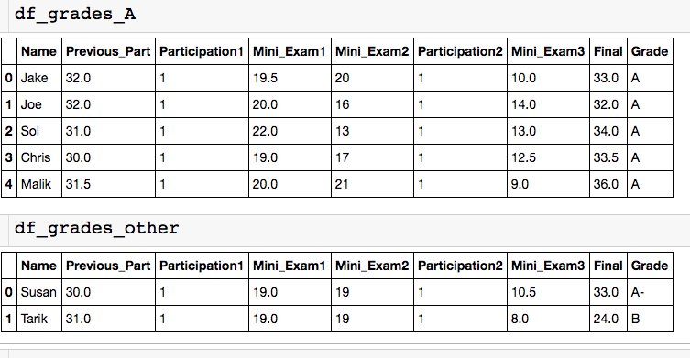
Concatenating DataFrames - Stacked
Let’s say you had separate csv files with the info for the students who got an A and everyone else, but you want to analyze everything together.

Slide 4
Concatenating DataFrames - Stacked
List of dataframes to concatenate

Slide 5
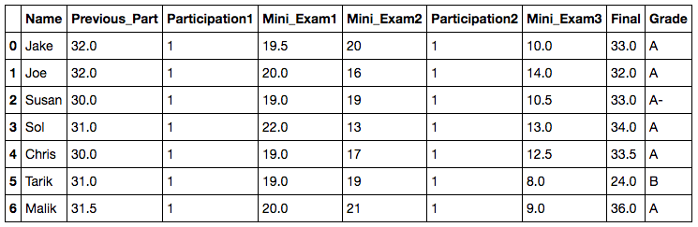
Using the Index
The index in this case is row numbers.
What if I want to quickly see Joe’s row?
I have to look up what row Joe is in.
Instead, I can make the index the column name.

Slide 6
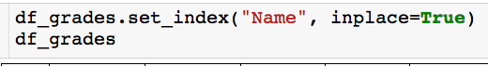
Using the Index
Column that will become index (make sure this is unique).

Slide 7
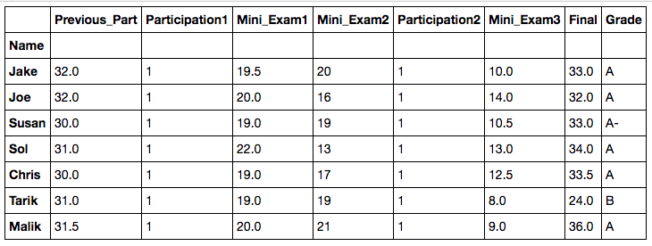
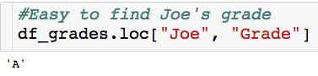
Using the Index

Slide 8
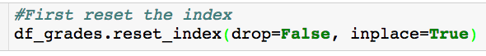
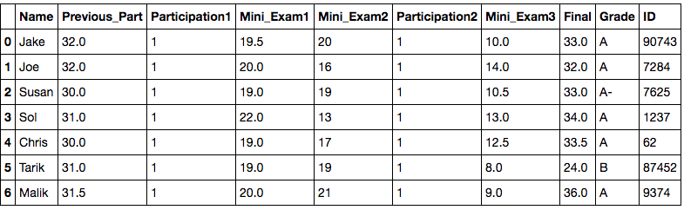
Using the Index
reset_index() will make your index row numbers again.
Useful when manipulating dataframes and index can get messed up

Slide 9
Advanced Pandas
Use string methods to create and manipulate columns
Map to quickly create indicators from categorical variables
Apply to create new columns that are complex functions of other columns.
Iterating through the rows of a dataframe

Slide 10
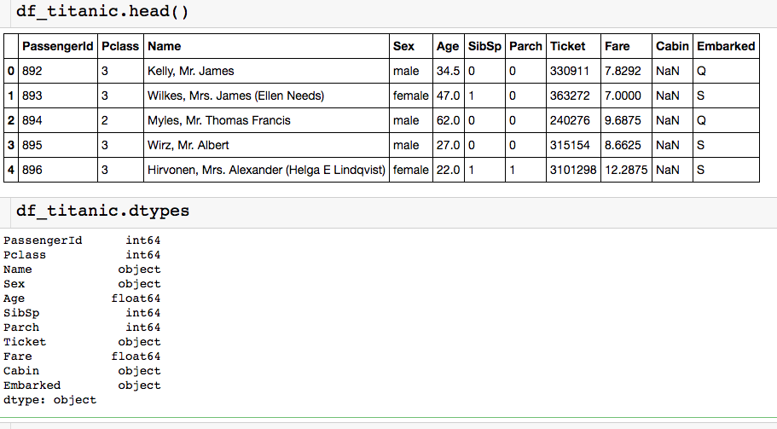
Titanic Data Set
Passenger data from people onboard the Titanic:

Slide 11
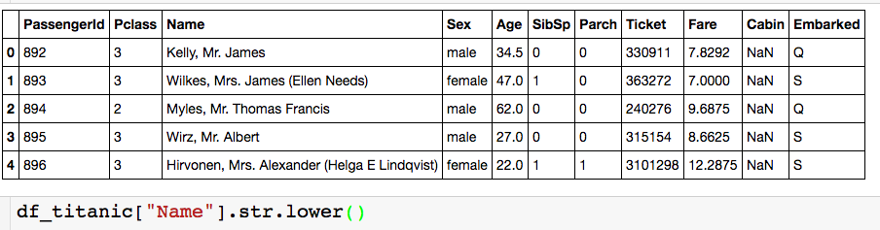
Using String Methods
.“string_method”
After column name you need .str if you wan to use a string method

Slide 12
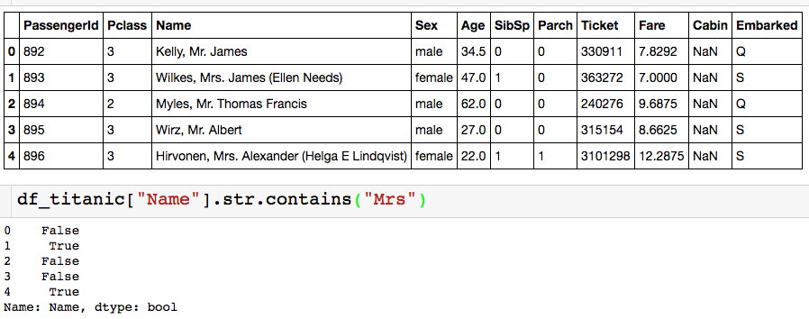
Using String Methods
Let’s say I wanted to know the proportion of “Mrs.” in the data set

Slide 13
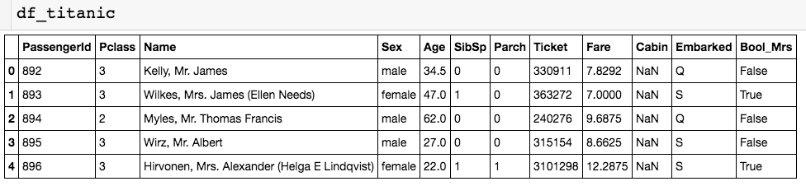
Using String Methods
Let’s say I wanted to know the proportion of “Mrs.” in the data set
Create new column column called “Bool_Mrs” that stores these booleans:
New column

Slide 14
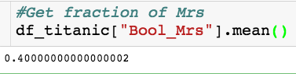
Using String Methods
Let’s say I wanted to know the proportion of “Mrs.” in the data set
Create new column column called “Bool_Mrs” that stores these booleans:

Slide 15
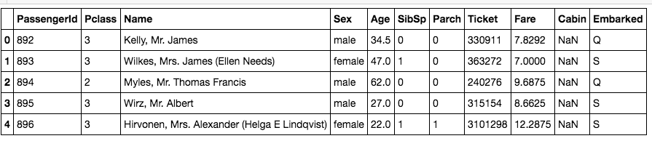
Using Map
Let’s say I wanted to know the proportion of females on the ship.
Using map - can only be used with single columns :
Dictionary:
Key: value in column
Value: mapped value

Slide 16
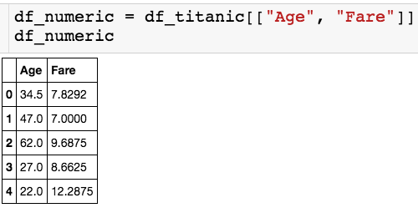
Using Apply
Let’s only pick out a couple of the numerical columns.
The apply() method lets us use custom or built in functions to multiple columns.
Let’s begin by applying built in functions…

Slide 17
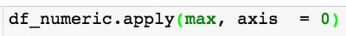
Using Apply
Let’s only pick out a couple of the numerical columns.
Name of function
Axis = 0 - apply column wise
Axis = 1 - apply row wise

Slide 18
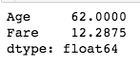
Using Apply
Let’s only pick out a couple of the numerical columns.
Returns series where the index is the column name.

Slide 19
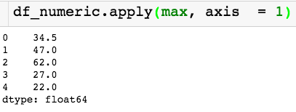
Using Apply
Let’s only pick out a couple of the numerical columns.
Changed axis!
Returns series where the index is the index of the dataframe.

Slide 20
Using Apply
Let’s only pick out a couple of the numerical columns.
Changed axis!
Returns series where the index is the index of the dataframe.

Slide 21
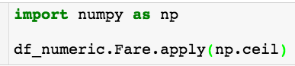
Using Apply
Let’s only pick out a couple of the numerical columns.
Applying numpy ceiling function to the column fare

Slide 22
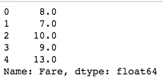
Using Apply
Let’s only pick out a couple of the numerical columns.
We can use apply to create new columns!

Slide 23
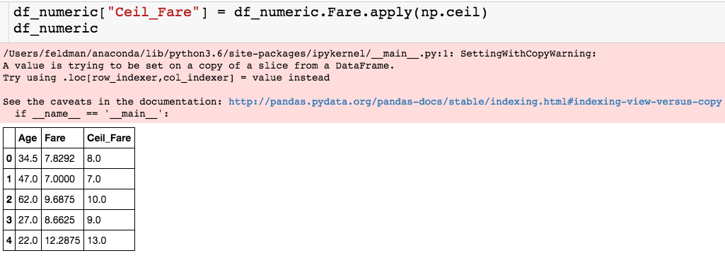
Using Apply
Let’s only pick out a couple of the numerical columns.
Pesky SettingWithCopyWarning
New column

Slide 24
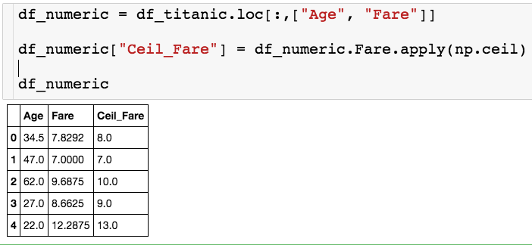
SettingWithCopyWarning
Two ways to avoid this warning:
Define df_numeric by slicing with .loc

Slide 25
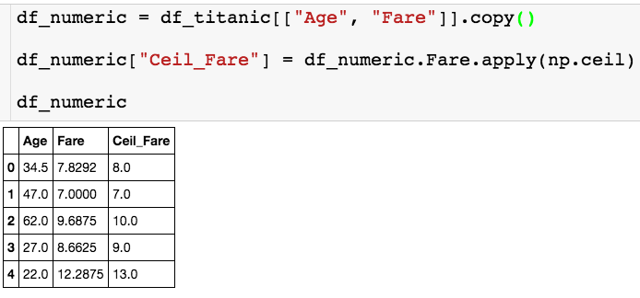
SettingWithCopyWarning
Two ways to avoid this warning:
or set df_numeric equal to a copy of the slice of the dataframe

Slide 26
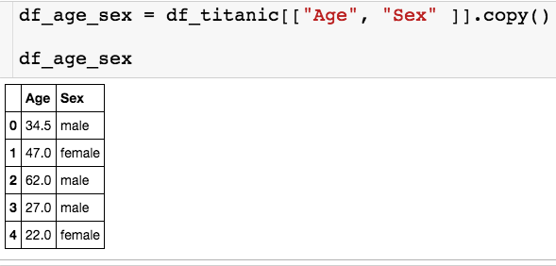
Using Apply
Let’s see how we can use apply with a custom function on a single column:
Let’s use apply to create a binary column that is 1 if the passenger is male and 0 if female.

Slide 27
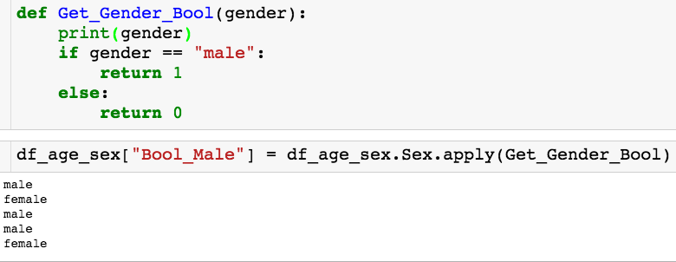
Using Apply
Let’s see how we can use apply with a custom function on a single column:

Slide 28
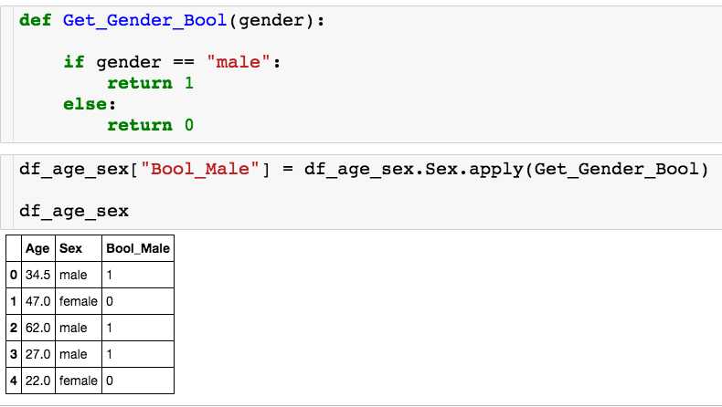
Using Apply
Let’s see how we can use apply with a custom function on a single column:
Calls Get_Gender_Bool once for each row.

Slide 29
Using Apply
Let’s see how we can use apply with a custom function on a single column:
Let’s use apply to create a binary column that is the passenger is above 60 years old and 0 otherwise.

Slide 30
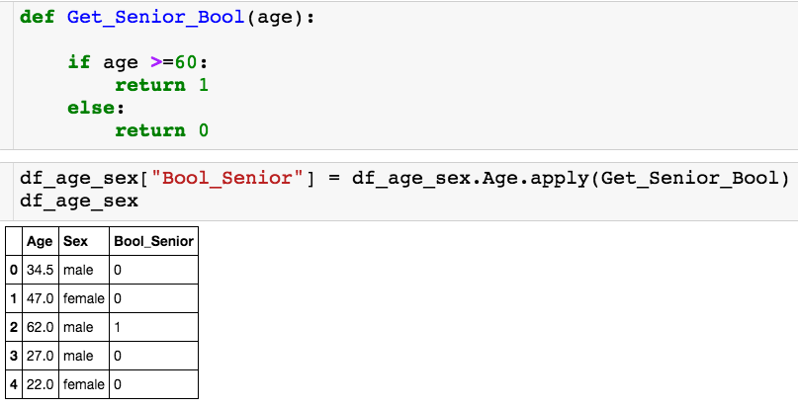
Using Apply
Let’s see how we can use apply with a custom function on a single column:
I’ll apply my custom function on the age column.

Slide 31
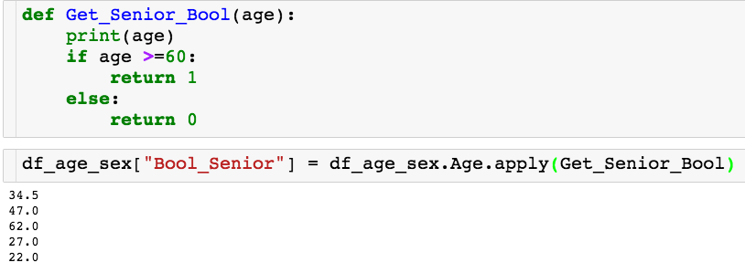
Using Apply
Let’s see how we can use apply with a custom function on a single column:

Slide 32
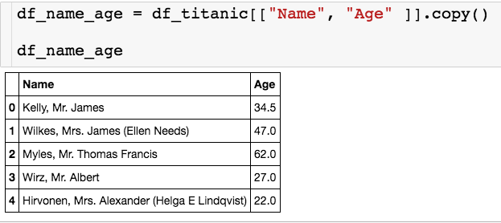
Using Apply
Last one:
Let’s use apply to a new column called Title that’s stores each passenger’s title (Mr./Mrs.)

Slide 33
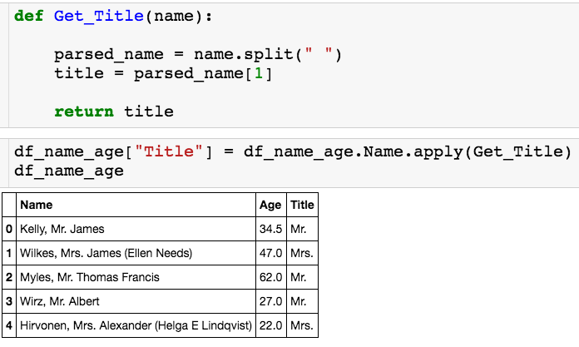
Using Apply
Last one:

Slide 34
Using Apply
Let’s see how we can use apply with a custom function on a data frame:
Let’s use apply to create a binary column is 1 if the passenger is male and over 60 and 0 otherwise.

Slide 35
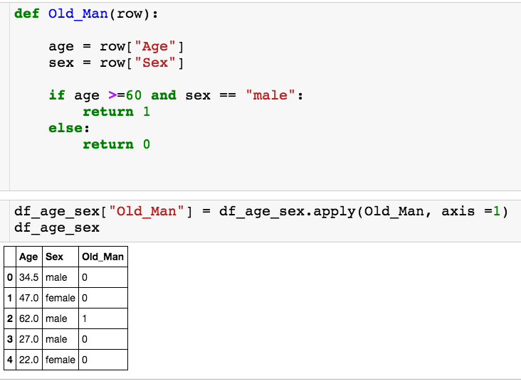
Using Apply
Let’s see how we can use apply with a custom function on a data frame:
Apply to entire dataframe
Apply to rows

Slide 36
Using Apply
Let’s see how we can use apply with a custom function on a data frame:
Each row gets passed as a series to the function, where the column names are the index.

Slide 37
Using Apply
Let’s see how we can use apply with a custom function on a data frame:
Each row gets passed as a series to the function, where the column names are the index.

Slide 38
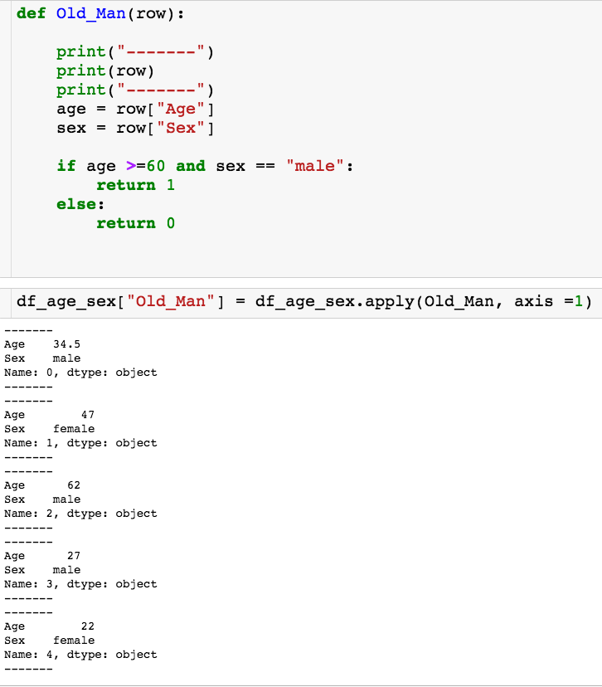
Using Apply
Let’s see how we can use apply with a custom function on a data frame:
The function Old_Man gets called for each row in the dataframe.

Slide 39
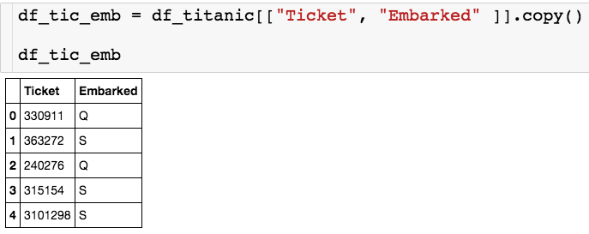
Using Apply
One more example:
I want to create a new column is embarked plus the first number of the ticket. So, in the first row, this new column should read “Q3”

Slide 40
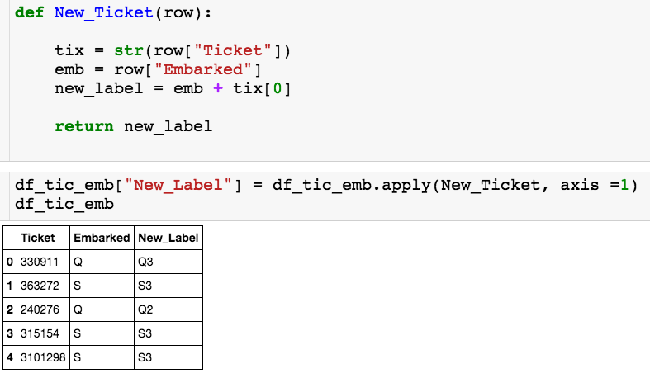
Using Apply
One more example:

Slide 41
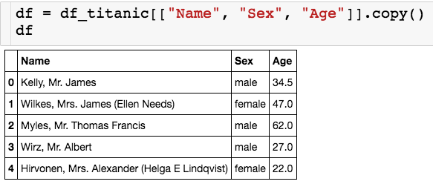
Iterrows
You can use the iterrows() method to go through the rows of a dataframe using a for loop.

Slide 42
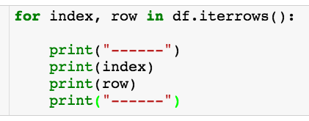
Iterrows
Returns two loop variables
Index of df
Row as series

Slide 43
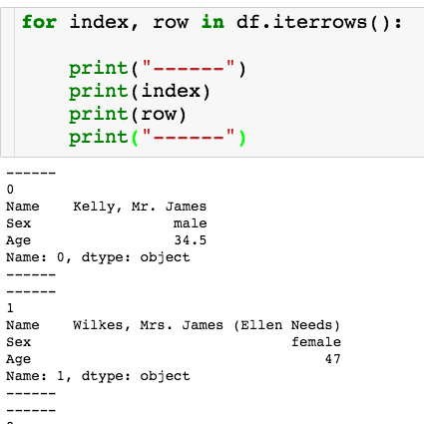
Iterrows

Slide 44
Iterrows
Let’s say I want to create a dictionary where I have an entry for each passenger where the key is the last name and the value is the age.

Slide 45
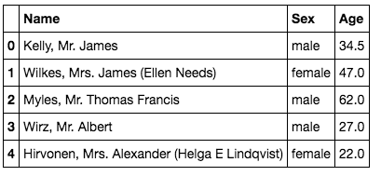
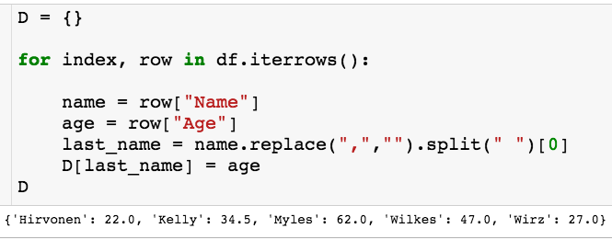
Iterrows

